Slide 1
World war one
Arnos vale war memorial

Slide 2
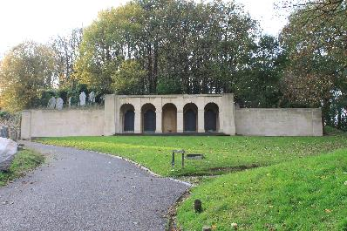
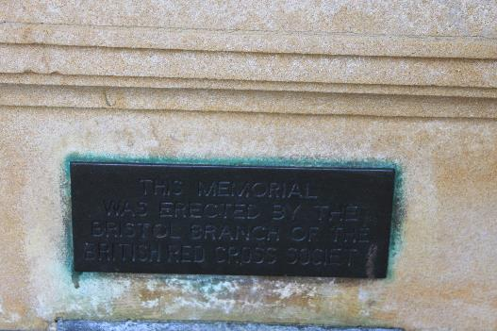
Arnos Vale Cemetery
I live next to Arnos Vale Cemetery in Bristol. All admittances to Southmead hospital, also in Bristol, that died in the first world war were buried in Arnos Vale. A memorial was built with the names of all who were buried in Arnos.

Slide 3
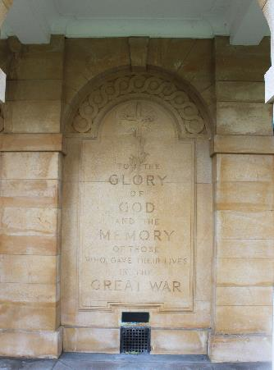
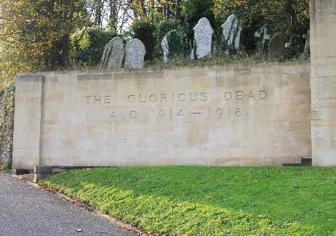
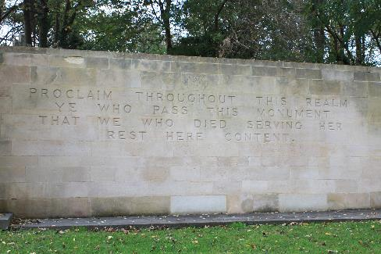
The memorial
Countries represented:
Great Britain and Northern Ireland
Canada
Australia
Ireland

Slide 4

The mystery sister
When I went to Arnos Vale I saw something different. There was only one woman buried there, Sister Eileen Mary O'Gorman.
I did some research and found out that she was an Irish Roman Catholic nurse working for the TFNS. I also found a plaque commemorating her in St Anne’s Cathedral in Belfast.

Slide 5
Ranks and abbreviations
CPL = corporal
PTE = private
SEAMAN = sailor
CQMS = company quarter master sergeant
AIRMAN = pilot (they only started having planes for this war)
L/CPL = lance corporal
MAJ = major
PENR = private engineer
DRVR = driver
SGT = sergeant
BMDR = bombardier
RFLM = rifle man
WORKER = worker
GNR = gunner
SPR = sapper
STKR = stoker
TFNS = territorial force nursing service

